Slide 1
CtrlFlow
Group 17
Yoseph Hassan
Muhamad Elassar
Joseph Mansy
Vinh Tran

Slide 2
Team Members:
Yoseph Hassan Computer Engineer
Joseph Mansy Computer Engineer
Muhamad Elassar Computer Engineer
Vinh Tran Electrical Engineer

Slide 3
Project Goals & Objectives
Yoseph Hassan

Slide 4
Motivation
Current HVAC systems are not flexible enough to provide temperature zones
Extremely inefficient
Imbalance in temperature throughout household
Different individuals desire different temperatures
Improve overall conventionality
Existing similar products are expensive and often ineffective

Slide 5
Solution/Goals
Design IoT system for smart AC
Provide proof of concept which can be easily scaled
Implement distributed system with multiple microcontrollers
Develop mobile application which connects to central hub via WiFi
Allow users to individually control temperature in different rooms
Design an easy to use application interface for controlling
Allow IoT system to maintain temperatures in different rooms

Slide 6
System Requirements
Independent temperature control per room
Update of temperature targets via web application interface
Easily scalable into full size model
Components will communicate wirelessly
System shall sense temperature readings within ±1°C
Central hub will interface with existing home HVAC system
Central hub sends signals to vent dampers

Slide 7
Software Requirements
Mobile application will communicate with central hub via WiFi and a cloud service.
Mobile application will handle temperature request and relay them over to the central hub.
Application will allow for a feature which registers specific users associated with certain rooms.

Slide 8
Constraints & Restrictions
Budget Limit: $450
Total power draw: ≤10w
Relatively easy to use
30 minutes to learn all features
Easily scalable interface

Slide 9
System Design & Implementation
Joseph Mansy

Slide 10
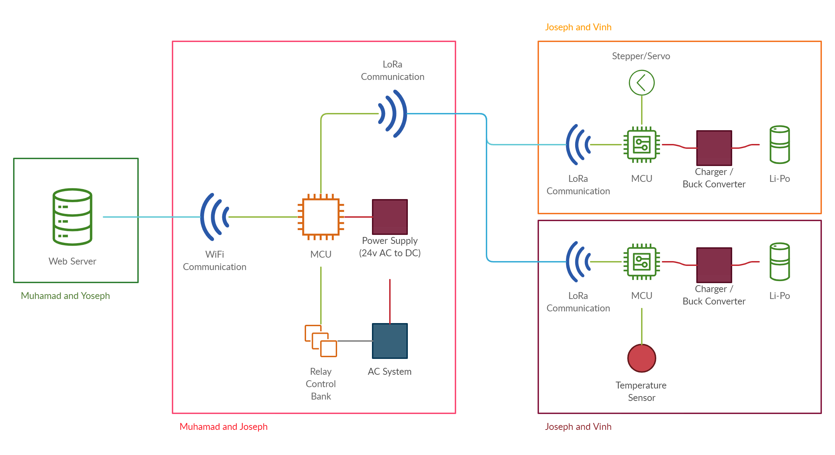
System Design
Central IoT Hub
Temperature Sensors
Controllable Air Vents
Cloud Services
Mobile Application
Miniature Model
Peltier Effect

Slide 11
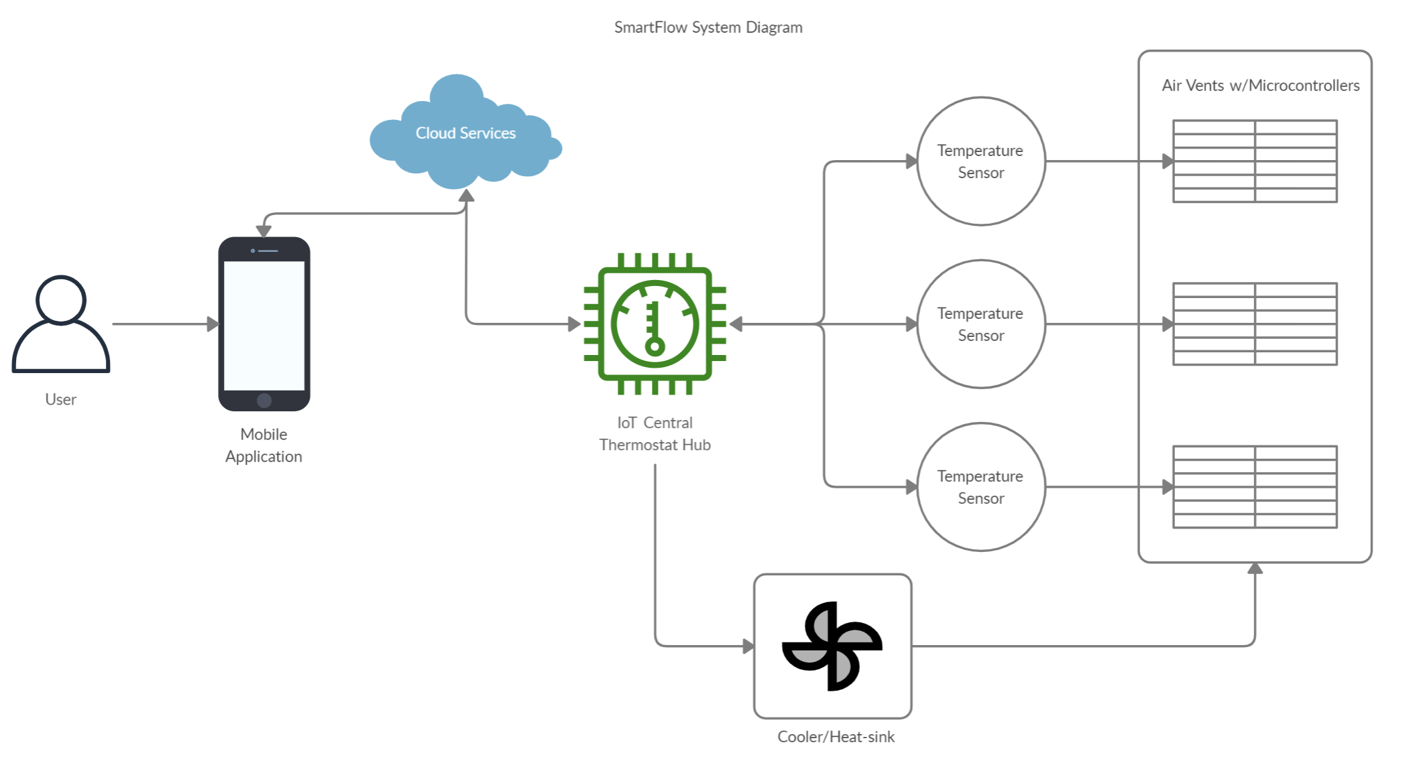
Embedded System Architecture
Hub is central control
Interfaces with cloud
Reduces costs of peripherals
Peripherals
Much Lower cost
Directly communicates only with the hub

Slide 12
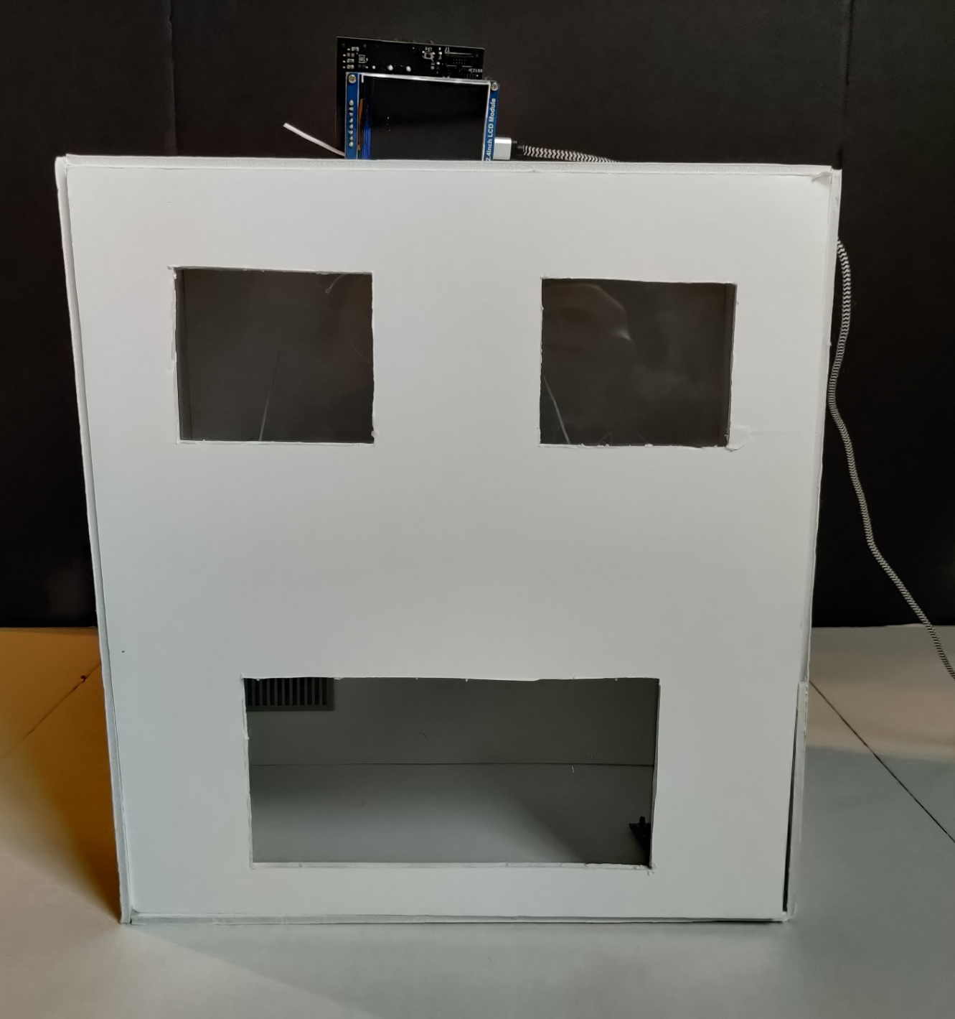
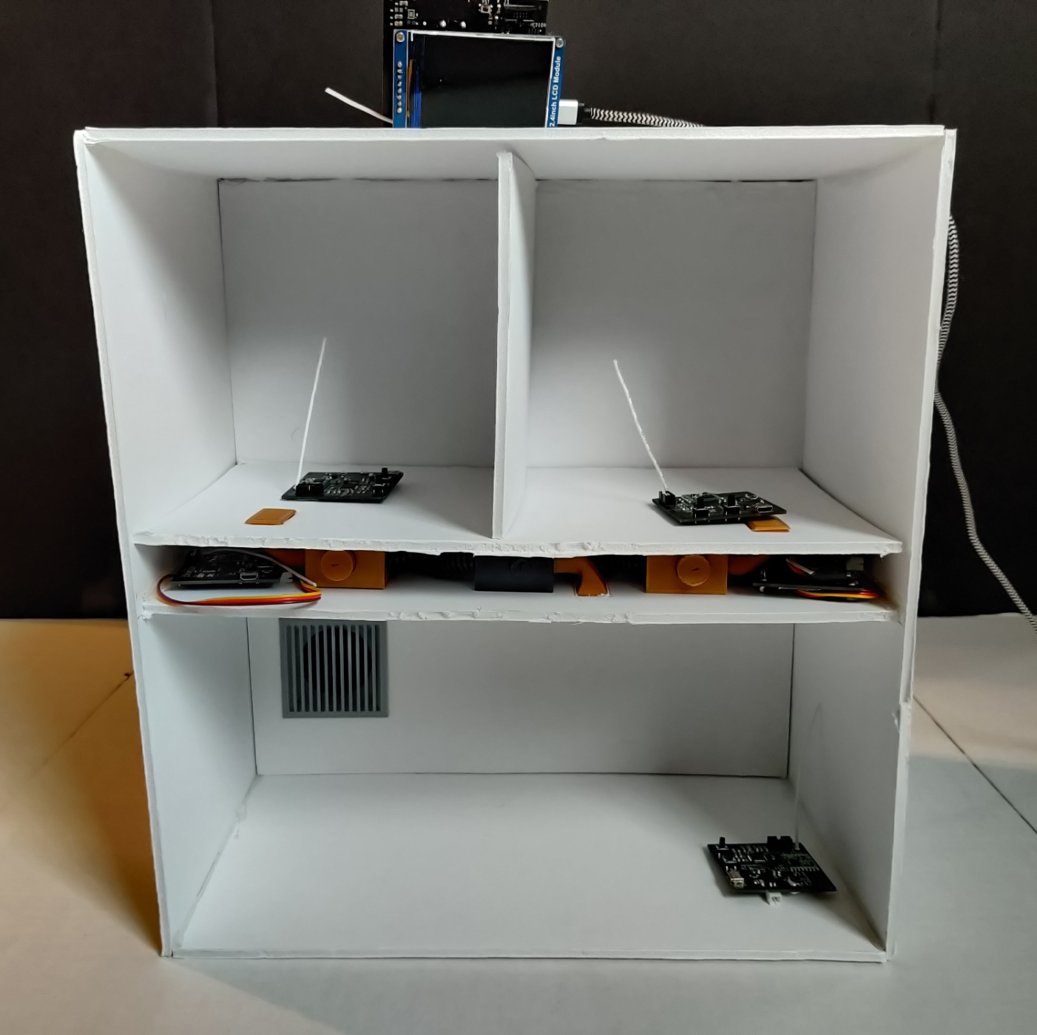
Thermoelectric Cooling
Rather than Integrating in a full scale home it was best to apply the system in a miniature model
Peltier Units allow for a close analog to the heat pump in an AC unit
Allows for a presentable small scale model of the system

Slide 13
Significant choices & decisions
Vinh Tran

Slide 14
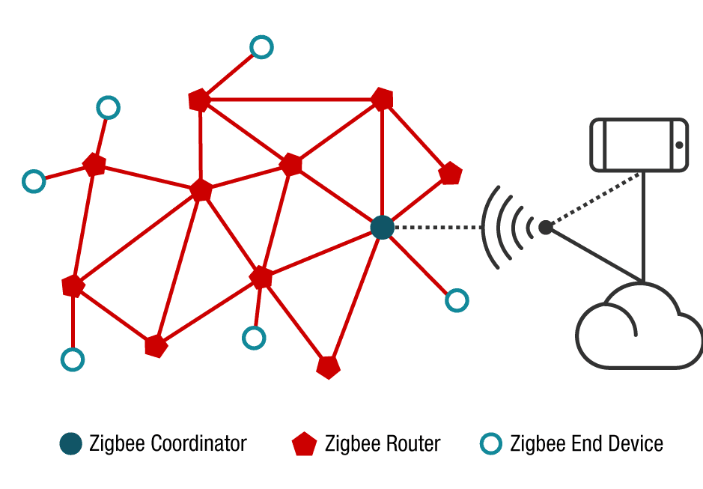
Connection consideration: Zigbee
Mesh topology
Requires a gateway device (aka Zigbee hub) to integrate to cloud. Gateway device also act as a coordinator in the mesh network
TI suggested solution required a Linux based device, making it not suitable for Senior Design 2
Open Thread (Zigbee’s successor), also requires linux devices

Slide 15
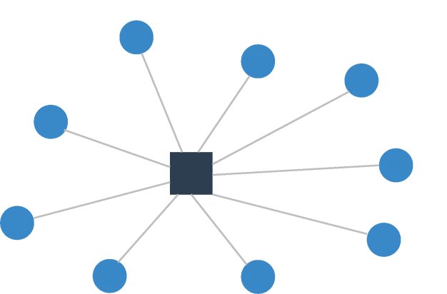
Connection consideration: LoRa
Star topology
Utilized LoRa (long range), allowing long distance connections
Abundant Arduino libraries from previous maker, providing useful function to transport data through cloud services
Arduino libraries for LoRa extension are also readily available

Slide 16
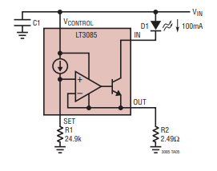
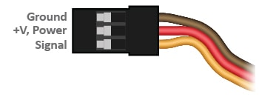
Actuator consideration: Servo
Servo consume a lot of power, as a standard servo can have stall current up to 1 Amps, not suitable for long time operation such as IoT
A load switch can be used to control the servo’s power pin, turning off when it’s not in use
A solution for future revision is to add a current regulator, keeping the current through the servo at a constant current

Slide 17
Realistic design constraints
Vinh Tran

Slide 18
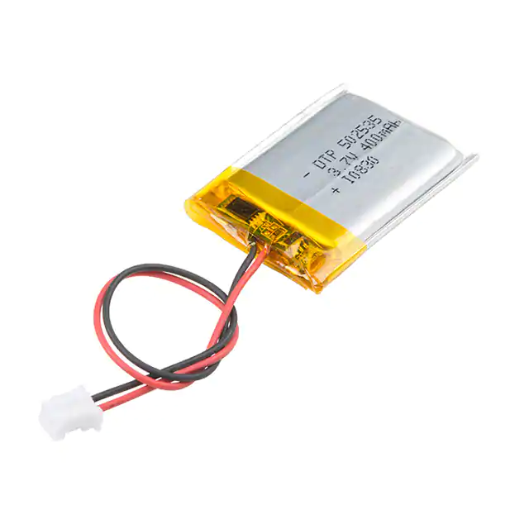
Safety concern: Lipo batteries
Can be a fire hazard if poorly made, poorly protected
Need to be protection against physical impact and production errors (can lead to overcharged, or shorted terminals)
Must consider purchasing high quality, with protection circuit, lipo batteries from trusted manufacture

Slide 19
Internet of Things (IoT) & Mobile Application
Muhamad Elassar

Slide 20
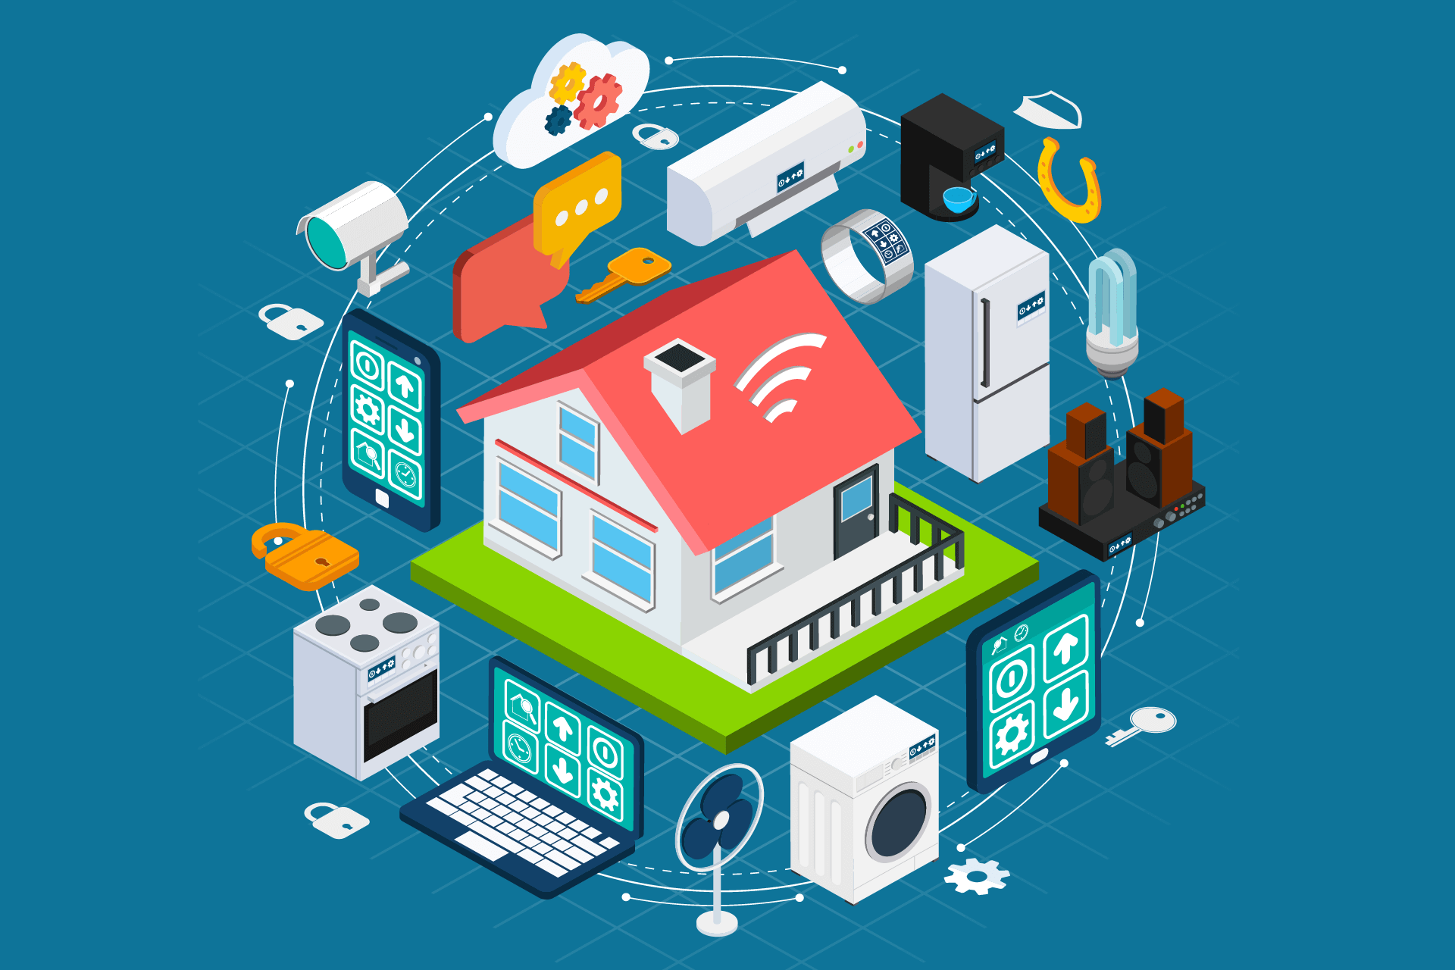
Internet of Things (IoT)
Describes the network of billions of physical devices that are connected to the internet, all collecting and sharing data.
Devices known as “things”.
Includes sensors, software, and other technologies.
Data is sent to the cloud to be analyzed and managed.

Slide 21
Cloud Services
Acts as connector to manage data that is sent/received between IoT devices
Mobile application sends commands to cloud service and receives data back.
User’s data is stored in the cloud
Top choices: AWS IoT, Microsoft Azure IoT, Google Cloud IoT, Arduino IoT Cloud
We have decided to move forward with Arduino IoT Cloud

Slide 22
Mobile Application
Allows user to interface with IoT devices so they can view and send data.
Displays different room temperatures.
User can change the temperature in each room with click of a button.
Decided to go with cross-platform framework to allow both Android and iOS users.
Top choices: React Native, Flutter, Arduino IoT Cloud built-in dashboard
Final Choice: Arduino IoT Cloud
Took advantage of Arduino IoT built-in dashboard

Slide 23
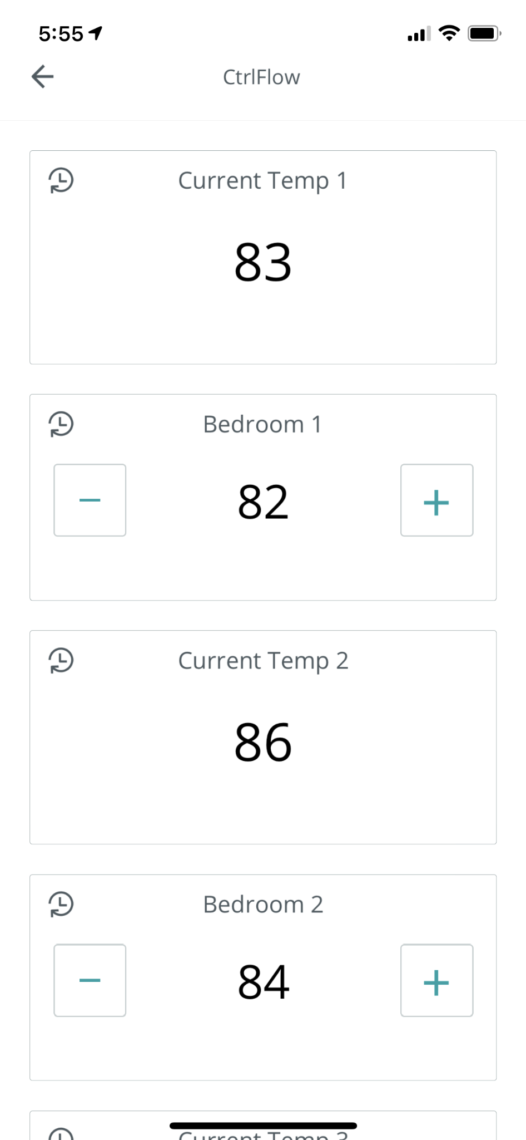
Mobile Application

Slide 24
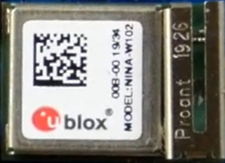
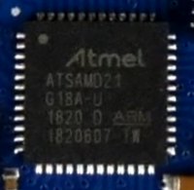
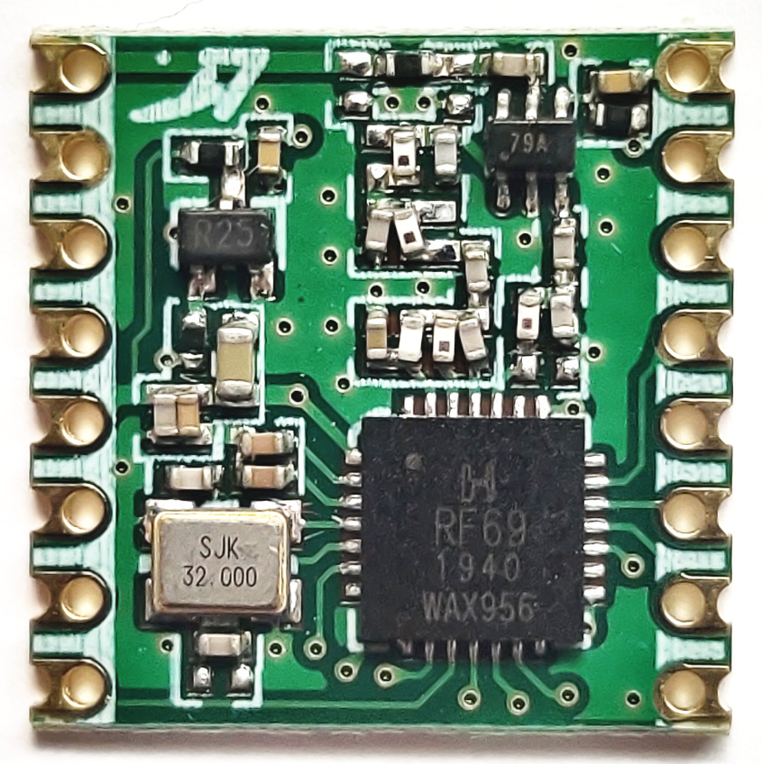
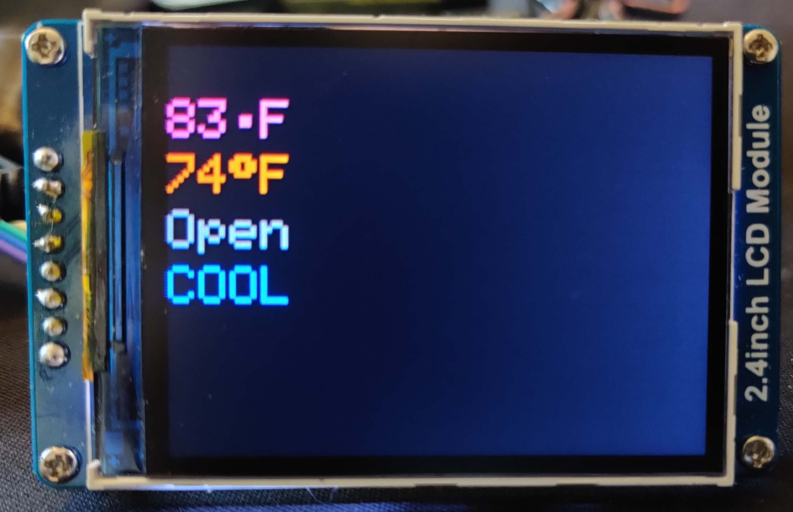
Central IoT Hub
Receives temperature commands from user via WiFi
Sends commands to air vents and temperature sensors via LoRa
Tracks reported temperatures from each room and determines which vent to open/close
Board Specifications
MCU: Arduino ATSAMD21
WiFi: U-Blox NINA-W102
LoRa: SparkFun Elect RFM69HCW
Power: 12v to 3.3v Buck Regulator, Texas Instrument
LCD: 240 x 320 Color LCD

Slide 25
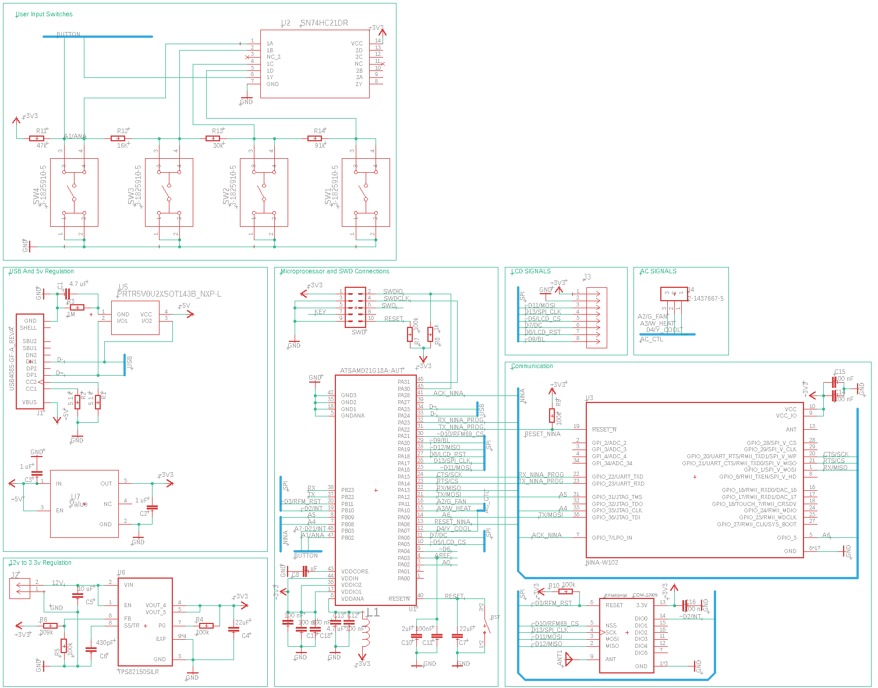
Central IoT Hub

Slide 26
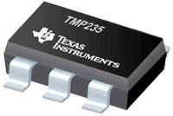
IoT Sensor
Sends temperature readings to Central Hub periodically
Senses temperature readings to within +/- 1°C
Board Specifications
MCU: Arduino ATSAMD21
LoRa: SparkFun Elect RFM69HCW
Sensor: Texas Instruments Analog Temperature Sensor TMP235A4DCKR

Slide 27
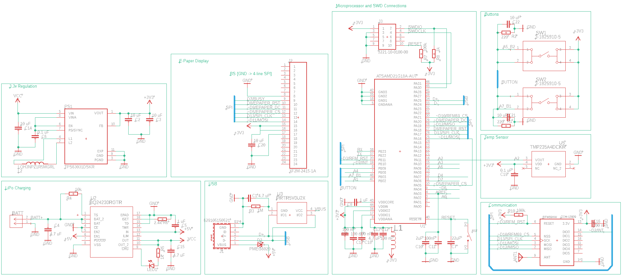
IoT Sensor

Slide 28
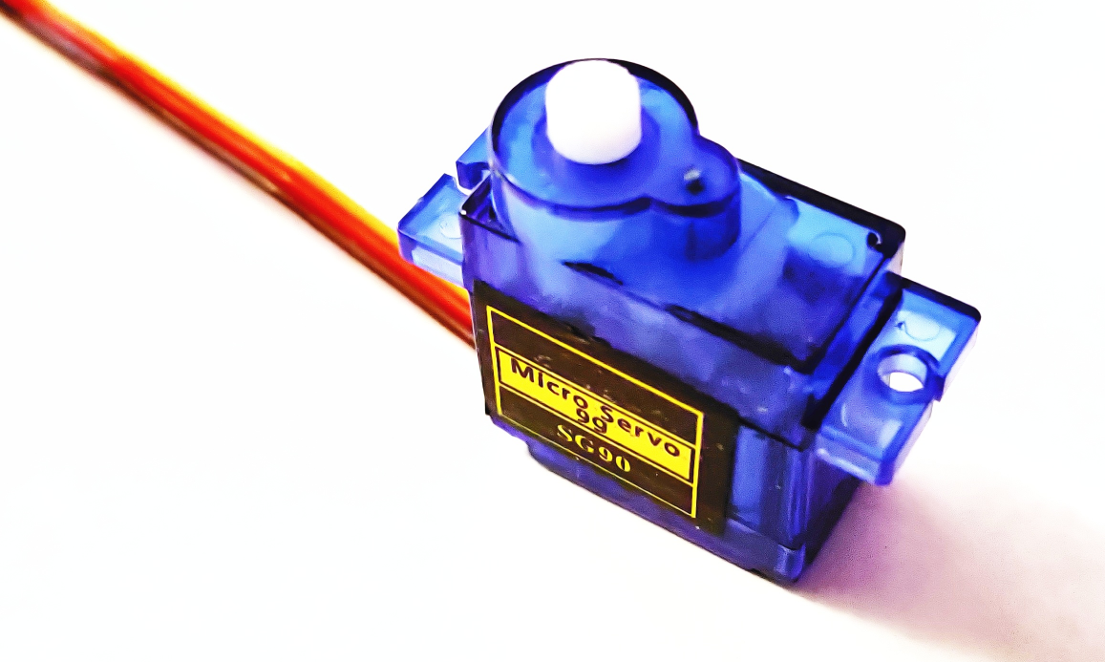
IoT Vents
Takes commands from the hub to open and close vents with the servo
Board Specifications
MCU: Arduino ATSAMD21
LoRa: SparkFun Elect RFM69HCW
Servo: SG-90

Slide 29
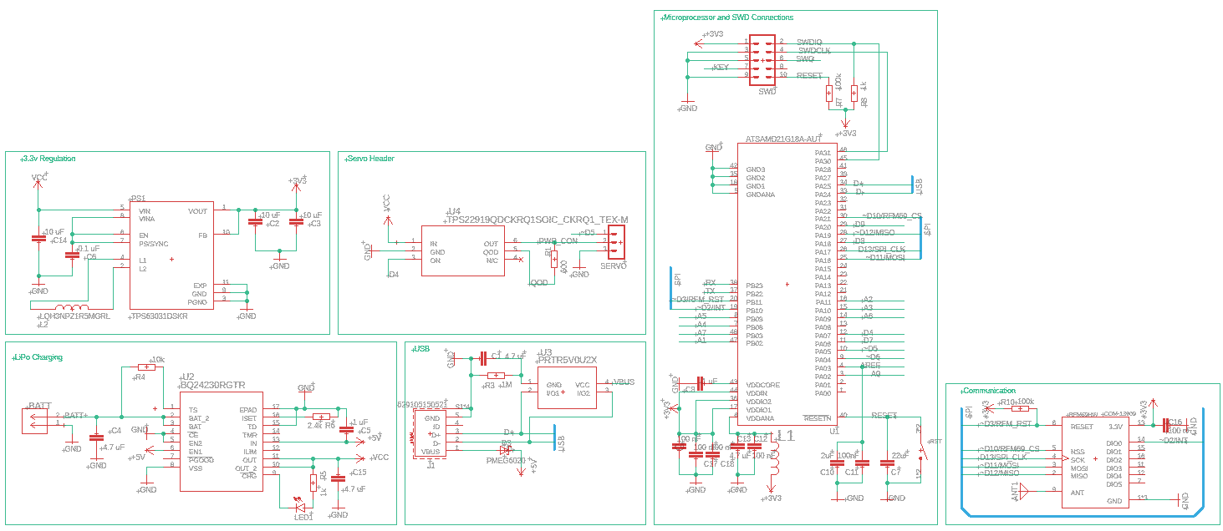
IoT Vents

Slide 30
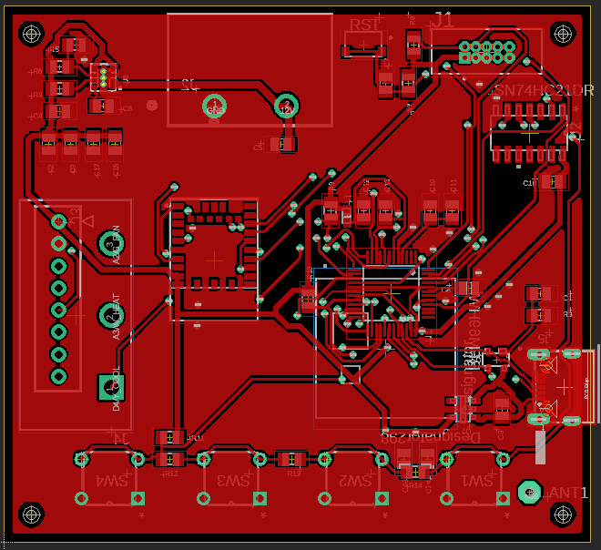
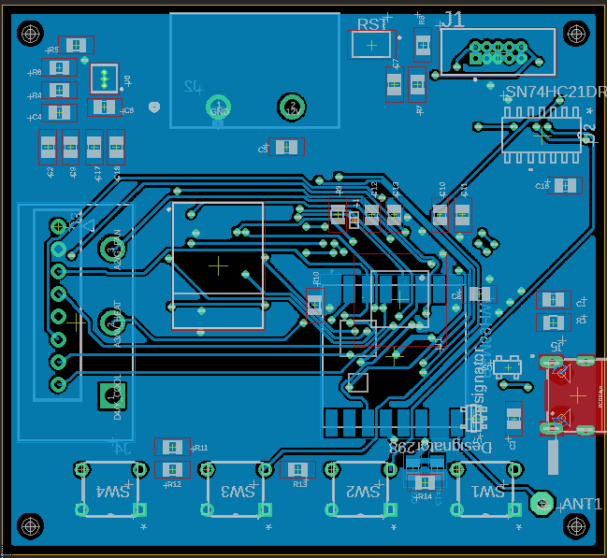
Central IoT Hub

Slide 31
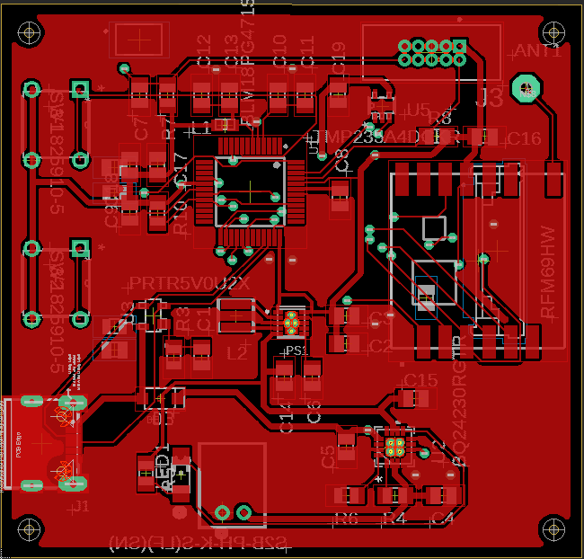
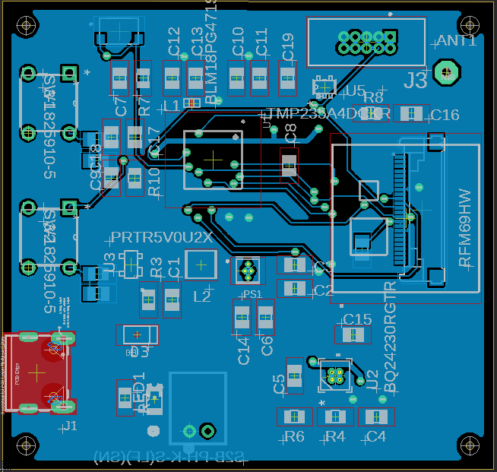
IoT Sensor

Slide 32
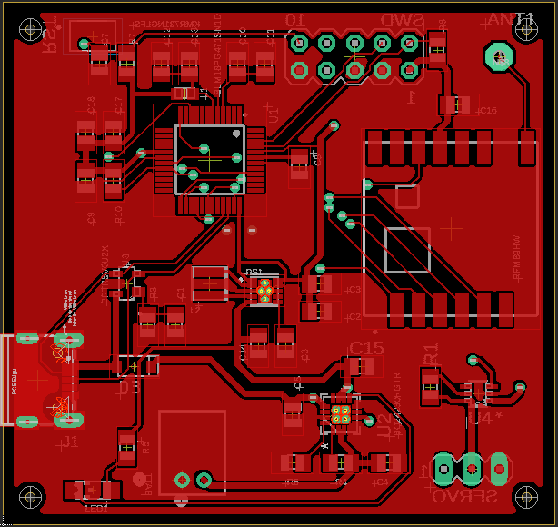
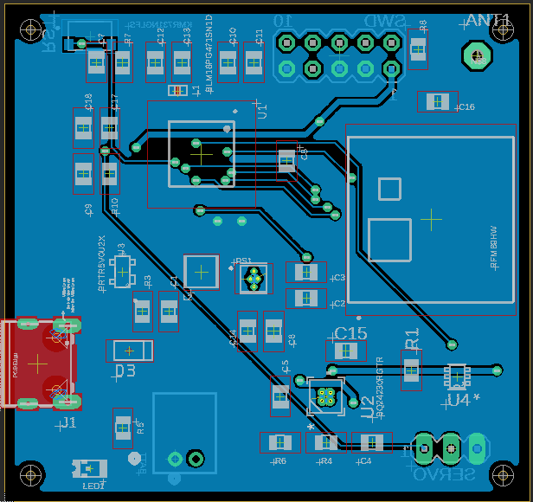
IoT Vents

Slide 33
Successes and Difficulties
Joseph & Muhamad

Slide 34
Mobile Application/Cloud
Successes
Arduino IoT Cloud provides easy-to-use front end functionalities
Smooth debugging process
Difficulties
Limited hardware to test with
Need to constantly make sure is compatible with any embedded changes

Slide 35
Embedded/Hardware
Successes
Hardware is more than powerful enough
LoRa radios are more than powerful enough to reliably transmit across a full scale house
Tests show transmission from 300ft
Difficulties
Arduino IDE is limited
VS Code + PlaformIO mitigates this
Wiring issues
Bugs may be software or hardware
Changes in design mean pcb needs to be updated
Delays ordering of parts

Slide 36
Administrative Content
Yoseph Hassan

Slide 37
Project Budget
Sub System | Item | Quantity | Price Per Item | Price Estimate
Central Hub | WiFi Module | 1 | $8 | $8
 | LCD Display | 1 | $9 | $9
 | Relays | 3 | $5 | $15
IoT Sensor | Temperature Sensor | 2 | $0.5 | $1
IoT Vents | Servo | 2 | $5 | $10
All | Custom PCBs & SMD Components | 5 | $20 | $100
 | MCU | 5 | $3 | $15
 | Radio Module | 5 | $5 | $25
Heating & Cooling System | Peltier Module | 1 | $10 | $10
 | Heatsink | 1 | $15 | $15
 | Fan | 1 | $5 | $60
Misc | Arduino Dev Kits | 3 | $20 | $60
 | Cloud Services | 1 | $10 | $10
 |  |  | Total | ~ $430

Slide 38
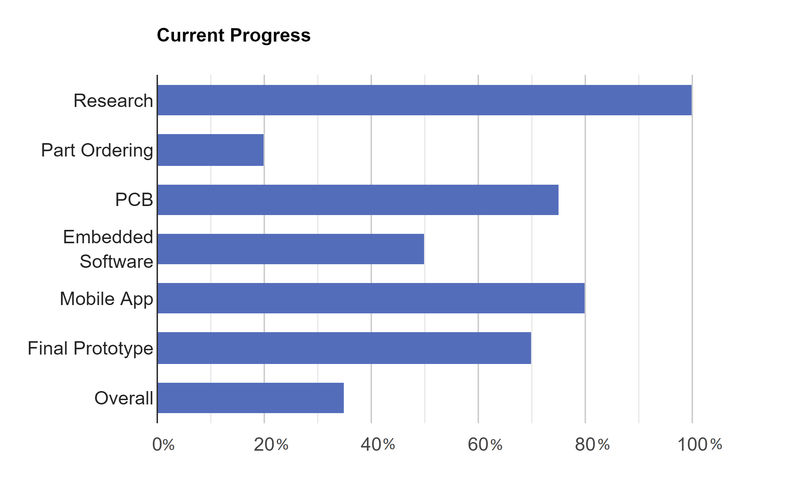
Overall Progress:
Notes:
https://www.rapidtables.com/tools/bar-graph.html

